Slide 1





Car Insurance Claim
Capstone Project
Conducted by:
Sayantan Sarkar
Notes:
Good afternoon, Today I would present you a capstone project on Car Insurance claim using data analytical tools and elementary machine learning algorithms where we would solve a classification problem on whether a person would opt for a claim or opt out of it based on some dependent features.

Slide 2




CONTENTS
1
6
Introduction
Insights
2
7
Objective
Data Modelling
3
8
Dataset
Recommendations
4
Tools
5
Data Manipulation Process
Notes:
The contents of the project goes as first we will have a brief introduction about the project what it is all about and the problem statement we have in hand. Then we will move to the objective where will discuss the possible outcome we want to accomplish followed by the outlook of the dataset’s specifications.
Then will briefly look at the tools we have used to clean and model our data.
We will comprehensively go through the data manipulation process to learn the implemented data cleaning methods
The insights we discover using analytics out of the dataset.
Once we are done with data wrangling, we then are good to move to our final step of the solution; that is data modelling where we will fit our data to the most frequently used ML classification algorithm and will check for the most accurate prediction and verify out a generalized model.
The very last step bears the recommendation where we will conclude the solution of our today’s project and thus will close the session. So without further due, lets move on to the next slide…

Slide 3


INTRODUCTION
Automobiles in todays generation has gradually became the necessity of every family, the car insurance also becomes more and more prosperous for auto insurance companies, to maximize revenue, they must sell corresponding insurance plans to different customers. However, because the types of customers are so diverse and the correlation between the characteristics is not obvious, the use of simple statistics cannot enable insurance companies to make accurate judgments about customers. With the advent of machine learning, more models are available to learn data in depth. Thus, more accurate predictions can be achieved. Therefore I have developed a predictive model that assesses the claim probability for car insurance policies.
Notes:
In the fast-paced world we live in today, cars have become an integral part of our lives and fundamentally changed the way we live, work and communicate. From daily commutes to cross-country trips, cars offer unrivaled comfort, freedom and mobility. As the need for personal transportation grows, the importance of automobiles in modern life cannot be overstated. Yet, we cannot deny the fact that driving on Indian roads has its share of perils. To financially secure oneself from any such incidents or accidents, it is a wise decision to have a motor insurance policy in place. Hence the car insurance also becomes more and more prosperous for insurance companies, to maximize revenue. However, because the types of customers are so diverse that the insurance companies are unable to make accurate judgements about the customers. So today with the advent of ML we will learn data in depth and build models to accurately predict the claim probability for car insurance policies.

Slide 4

Objective
The objective would be to understand the factors that influence claim frequency and severity in the period of six months and enable insurance companies to better assess risk and determine appropriate premiums for policyholders.
Notes:
So our objective here would be to understand the factors that influence claim frequency and severity in the period of six months and enable insurance companies to better assess risk and determine appropriate premiums for policyholders.
At this point I would like to humbly ask if you have any doubts/queries/questions?
Moving on to the next slide…

Slide 5

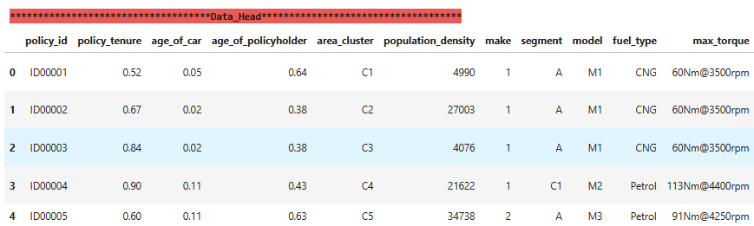
DATASET
1
6
1. | Dataset Name | Insurance_data (CSV format)
2. | Data Structure | Observations – 58592
 |  | Features – 43
3. | Target Variable | “is_claim”
4. | Categorical columns | 31
5. | Numerical columns | 11
Notes:
Our dataset somewhat looks like the above figure illustrated with the metadata tabled below the illustration.
Our data contains around 58592 observations and 43 are independent features.
Target variable goes by the name “is claim” which provide us the information whether a person would or would NOT claim for the insurance in 0 & 1. 0 being No and 1 being Yes.
We have total of 31 categorical features and 11 numerical features.
You are free to pause and ask me any queries/questions you may have.

Slide 6

TOOLS
SMOTE
Minmax Scaler
Chi-Squared Test
LGBMClassifier
SVC
Random Forest
Naïve Bayes
XGBClassifier
Cat Boosting
ANOVA Test
Matplotlib
Pandas
Notes:
For this project I have used Python programming language in Jupyter notebook.
The basic libraries used for data wrangling and cleaning were Numpy and Pandas.
Visualization was done using Matplotlib and Seaborn.
SKLEARN Imbalance library was used for balancing the dataset
Scaled the data using MinMax scaler
Chi-Squared test was used for categorical feature selection/Extraction and ANOVA for numerical feature selection/extraction
I chose 5 of the most commonly used ML classification algorithm were:
Extreme Gradient Boosting Classifier
Naïve Bayes
Random Forest
LGBM Classifier and
Cat Boosting

Slide 7

Data Manipulation Process
Data Ingestion
Importing dataset
Exploratory Data Analysis (EDA)
Segregating feature/target variable
Data Pre-processing
Feature Importance of categorical fields using Chi-Square method
Feature Selection/Extraction
Outlier treatment
Drawing out the ROC_AUC curve and selecting the best model with highest accuracy score and maximum area under the curve
Predictive Modelling
Splitting data into train and test
Project Outcomes & Conclusion
Null value treatment
Remove useless columns
Check duplicate data
Visualizing categorical features
Visualizing numerical features
Label Encoding categorical data
Scaling data
Observing correlations of each features
Analysis of correlation of independent features vs dependent features
Feature Importance of numerical fields using ANOVA testing
Balancing dataset using oversampling technique
Fitting the data into the model
Notes:
Journey of manipulation of data started with Data ingestion where I imported the dataset, removed unnecessary columns, checked for null values and deleted any duplicate values.
Next I moved on to the EDA part where first I segregated the feature/target variable, visualized categorical features and numerical features.
In the Data pre-processing part, I capped the outliers, encoded the categorical features using Label Encoder. Scaled the data using Minmax scaler, observed correlation of each features through heatmap
As I already mention in the previous Tools slide, feature selection for categorical and numerical column was done using Chi-Square and ANOVA Test. To balance the data, I used SMOTE which is an oversampling technique.
In the predictive modelling, I had to split the data into train and test and fit the data in 5 of each of the ML classifiers.
ROC_AUC curve was drawn to select the model with highest accuracy score and covering the maximum area under the curve

Slide 8

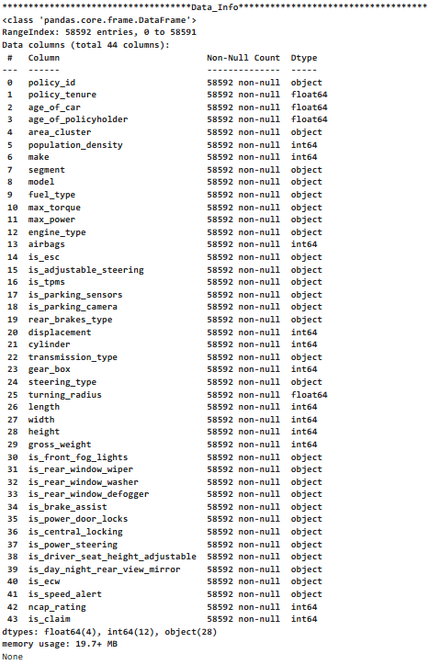
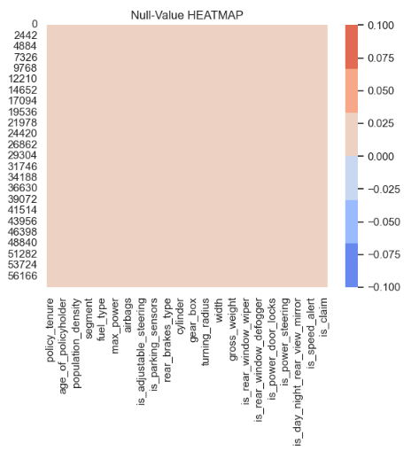
INSIGHTS
Observed no null values all over in the dataset.
Dataset contained 44 columns and 50k+ observations. “Policy ID” was dropped as was unique and unnecessary.
Notes:
These are some of the insights after my in-depth analysis:
Dataset has no null values
Dataset contained 44 columns and 50k+ obs
Policy ID was dropped as it was a unique column

Slide 9
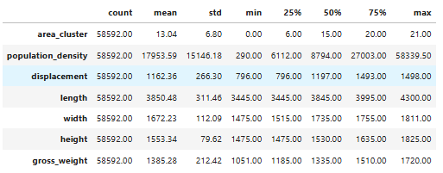
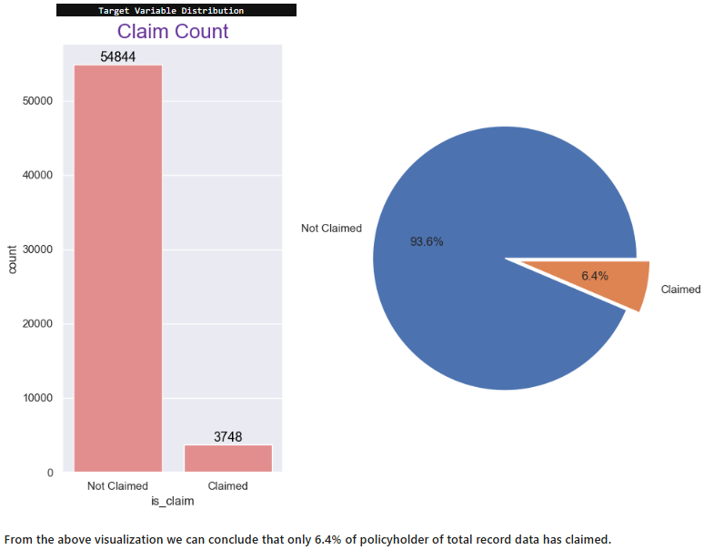
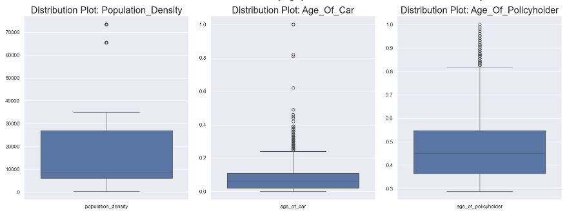
INSIGHTS…
I observed scaling of data was only necessary to few of the features whose mean was high.
My dataset is imbalanced and hence I fixed the same using SMOTE (oversampling) technique.
Distribution plot and box plot shows features 'Population Density', 'Age of Car' and 'Age of policy holder' have outliers.
Notes:
I observed that count of “Not Claimed” was approx. 54k which covered around 93.6% of the whole target variable values w.r.t “Claimed” count around 3748 that only covers 6.4%. Hence I could able to deduce that the data was imbalanced. SMOTE technique was used to balance the dataset
Scaling of data was only necessary to few of the features whose mean was high.
The boxplot shows features 'Population Density', 'Age of Car' and 'Age of policy holder' have outliers.

Slide 10
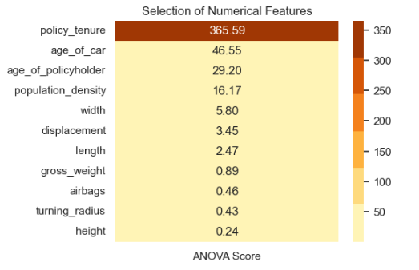
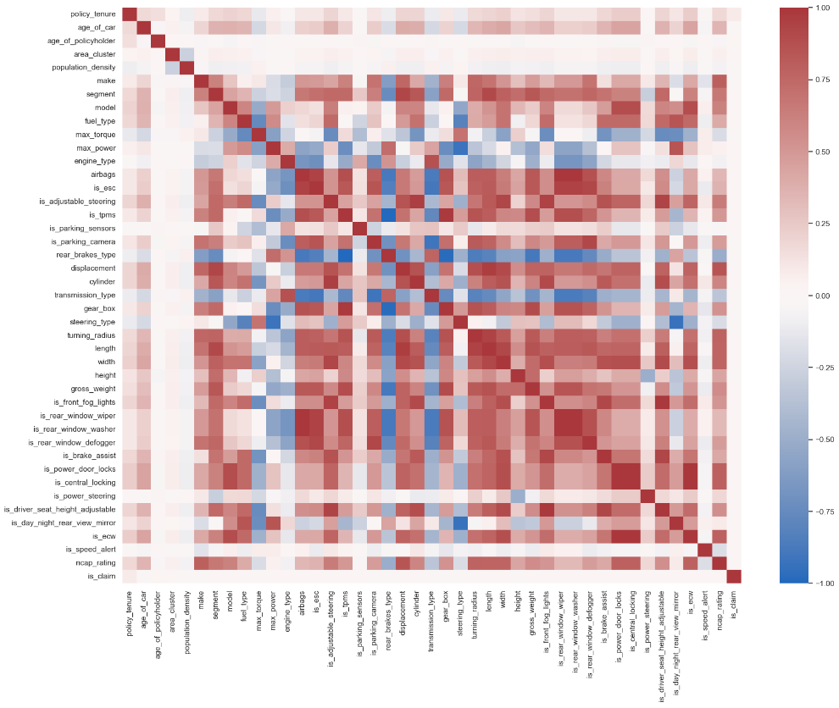
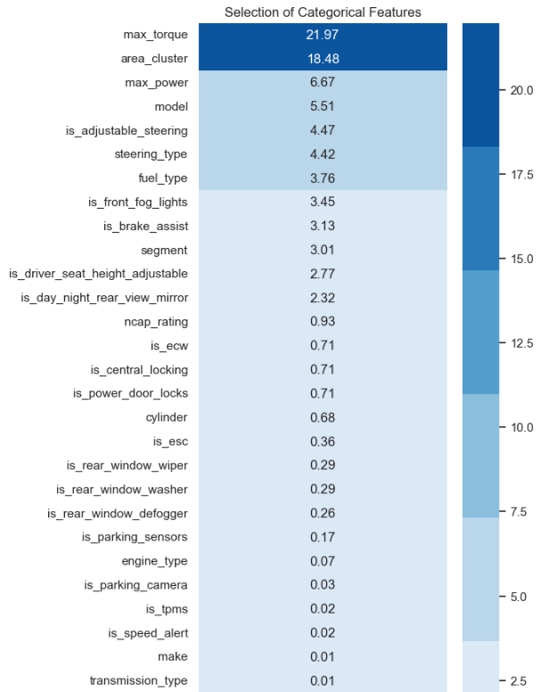
INSIGHTS…
Feature selection of numerical columns using ANOVA test, we can observe that the feature 'policy tenure' is highly impacting the Claims (dependent variable) whereas 'height', 'turning radius', 'airbags' etc. being the least important.
Observed the correlation of each of the features in the dataset using heatmap.
Feature selection of categorical columns using Chi-Square test, I observed that the features ‘max torque' and 'area cluster' is highly impacting the Claims (dependent variable) whereas 'gearbox', 'power steering', 'rear brakes type' etc. being the least important.
Notes:
Observed the correlation of each of the features in the dataset using heatmap.
The feature “Policy tenure” is highly impacting the Claims whereas Height, turning radius and airbags and least important
In categorical feature, area cluster is highly impacting the claims whereas 'gearbox', 'power steering', 'rear brakes type' etc are least impacting
Any questions regarding insights?

Slide 11

DATA MODELLING
Predictive Modelling
5 ML Classifiers
Random Forest Classifier
Accuracy Score – 90% ROC_AUC – 96.24%
XGBoost Classifier
Accuracy Score – 87% ROC_AUC – 93.31%
LightGBM Classifier
Accuracy Score – 92% ROC_AUC – 96.94%
Naive Bayes Classifier
Accuracy Score – 58% ROC_AUC – 59.92%
CatBoost Classifier
Accuracy Score – 93% ROC_AUC – 97.23%
Processed Data
Label Encoding Feature selection/Scaling
Notes:
Now coming to the modelling part where I fit the processed data in ML algorithms, I able to conclude that the highest

Slide 12

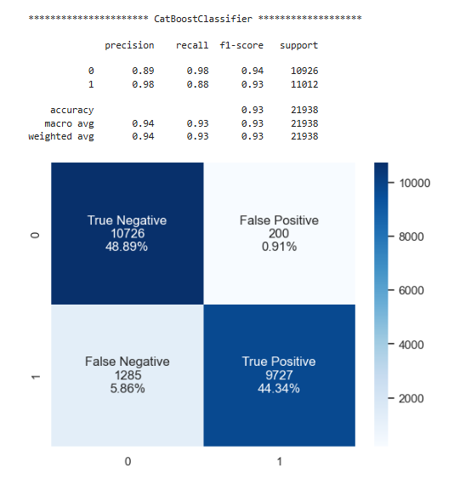
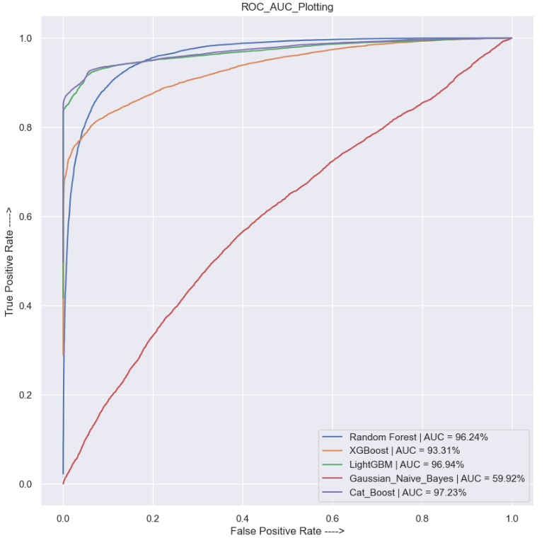
RECOMMENDATIONS
Plotting the Receiver Output Characteristics, Cat Boosting classifier occupied the maximum area under the curve with 97.23%
Out of the 5 ML classifier models Cat Boosting Classifier gave the maximum accuracy score of 93%. Hence I chose Cat Boosting Classifier as the recommended generalized model.
Notes:
My recommendation for predicting the insurance claim would go with Cat Boosting Classifier that gave the maximum AUC of 97.23% and accuracy score of 93%.
Where the FP consists around 0.91% and FN to a mere 5.86% which is way less as compared to other classifiers.

Slide 13

Thank You
GitHub link - Capstone-Projects/Insurance Project at c_projekt · deepsarkar0/Capstone-Projects (github.com)
Notes:
I have provided my github link to the project below the current slide.
So with the resolution of the issue I now wrap up my presentation. But before that I want to ask if there are any further questions/queries regarding the project.

